Slide 1
CTG Classification
using Patch-based Transformer
Jaleed Khan
Jones Group

Slide 2
Overview
Introduction
Antepartum CTG
Deep Learning in Antepartum CTG
Hypothesis
The OXMAT Dataset
Methodology
Training Data and Cohort Development
Data Pre-processing
Model Architecture
Results
Future work
Conclusion

Slide 3
Antepartum CTG
Among the commonest medical investigations performed during pregnancy
Monitors the Fetal Heart Rate (FHR) and uterine contractions (TOCO) before labour
Generally used for detecting fetuses in a state of wellbeing or at risk of an adverse outcome
Visual interpretation of CTGs is long-known to be unreliable, with inter-observer agreement as low as 29% and a false positive rate of ~60%
Current computerised assessment, done with the Oxford Dawes-Redman (DR) System, is limited to wellbeing only
Notes:
Antepartum CTG is the commonest medical investigation performed during pregnancy, which monitors the Fetal Heart Rate (FHR) and uterine contractions (TOCO) before labour
It’s used to detect fetuses in a state of well-being or at risk of an adverse outcome.
The visual interpretation of CTGs is highly subjective and unreliable, with inter-observer agreement as low as 29% and a false positive rate around 60%. This inconsistency can lead to unnecessary interventions or missed opportunities to prevent adverse outcomes.
Currently, computerized assessment is done with the Oxford Dawes-Redman System, but it is limited to assessing wellbeing only.

Slide 4
Deep Learning in Antepartum CTG
Deep learning models (CNN, LSTM and Transformer)
Outperformed the DR system for classifying normal and adverse outcomes with a maximum of 72% AU-ROC
Prone to overfitting with longer sequences, overlook local temporal features, and dilute features across channels
Patch-based transformers
process time series signals patch-wise to capture local features,
aggregate the features across extended look-back windows and
process each channel individually
Notes:
Deep learning models, including CNN, LSTM and Transformer, have outperformed the DR system for classifying normal and adverse outcomes with a maximum of 72% AU-ROC
These models are prone to overfitting to noise or irrelevant fluctuations in longer sequences, overlook local temporal features due to their point-wise attention mechanism, and dilute features across channels
Patch-based transformers divide time series signals into segments to capture local temporal features within each segment, aggregate the features across extended look-back windows to avoid overfitting and process each channel individually

Slide 5
Hypothesis
Patch-based transformers applied to antepartum CTGs (aCTGs) will
process local (accels, decels, etc.) and long-term (variability, sinusoidal patterns, etc.) temporal patterns in aCTG signals more effectively,
improve the detection of both healthy babies and those at an increased risk of adverse pregnancy outcomes and
lay the groundwork for more sophisticated tasks, including predicting specific adverse outcomes and risk levels.
Notes:
Our hypothesis is that applying..

Slide 6

The OXMAT Dataset
The Oxford Maternity Dataset (1991–)
211,000+ CTGs
250,000+ pregnancies
~250 clinical variables
Maternal and neonatal outcomes, Apgar scores, CBG values, birthweights, delivery, medications, ...
OXMAT
Notes:
OxMat is a curated collection of CTGs, which contains over 211 thousand CTG recordings from more than 250 thousand pregnancies collected since 1991.
It includes around 250 clinical variables that provide nearly complete data on critical maternal and neonatal outcomes such as Apgar scores, CBG values, birthweights, and delivery medications to name a few.
The completeness and scale of the OxMat dataset offer a solid foundation for developing AI-driven technologies to improve maternal and fetal health.
210k+ CTGs, 70k+ pregnancies, 200+ clinical var (old)
211k+CTGs, 250k+ pregnancies, and ~250 variables

Slide 7
Training Data and Cohort Development
Inclusion criteria:
Gestational age between 27⁺⁰ and 41⁺⁶ weeks
Known fetal sex
Maternal BMI between 15 and 40 kg/m²
Time before delivery of APO/Cases within 7 days
Exclusion criteria:
Duplicate CTGs or multiple CTGs from the same day
Indeterminable time the CTG was performed relative to delivery
OXMAT
Notes:
To select a representative and balanced sample of the dataset for model training and validation, we defined specific inclusion and exclusion criteria.
We included CTGs from pregnancies with gestational ages between 27 and 41 weeks.
We ensured that the fetal sex was known, and maternal BMI was between 15 and 40.
For the cases cohort, we constrained the time before delivery to within 7 days to focus on the most relevant period.
We removed duplicate CTGs or multiple CTGs from the same day to avoid redundancy.
CTGs with indeterminable timing relative to delivery were also excluded.

Slide 8
Training Data and Cohort Development
Categories:
Adverse Pregnancy Outcomes (APO) Cases: Specific adverse outcomes such as stillbirth, neonatal death, severe hypoxia, low Apgar scores, and NICU admission
Normal Pregnancy Outcomes (NPO) Controls: Normal pregnancy outcomes without adverse events
Matching using propensity scores based on confounding variables gestational age, fetal sex, maternal BMI, and other key covariates
OXMAT
Notes:
We categorized the data into two groups: Adverse Pregnancy Outcomes (APO) or Cases, and Normal Pregnancy Outcomes (NPO) or Controls.
The cases include specific adverse outcomes such as stillbirth, neonatal death, severe hypoxia, low Apgar scores, and admission to Neonatal Intensive Care Unit (NICU).
The controls represent normal pregnancy outcomes without any adverse events.
By defining these groups, we aim to develop a model that can accurately distinguish between normal and adverse outcomes.
For matching, we used propensity scores based on confounding variables like gestational age, fetal sex, and maternal BMI, to create balanced cohorts for model development.

Slide 9
Training Data and Cohort Development
Final Dataset for Model Development:
19,462 CTGs (9,731 in each category)
80-20 train-test split
Pre-processing Steps:
Adjust FHR (50-250) and TOCO (0-100) values
Normalize FHR and TOCO values to [0.0, 1.0]
Segment and/or pad signals to standard 1-hour segments
20,589 CTGs (10890 NPO/Controls and 9699 APO/Cases)
OXMAT
Notes:
After applying the inclusion and exclusion criteria and performing matching, we arrived at our final dataset for model development, which consists of 19,462 CTGs, split equally between cases and controls.
We performed several pre-processing steps to prepare the dataset for model training.
We adjusted and normalized Fetal Heart Rate and Uterine Contraction signals to bring them within a practical range.
We segmented longer CTG signals and padded shorter CTG signals into standard 1-hour segments to make the input signal lengths consistent for modelling.
After pre-processing, we had a resulting dataset of 20,589 CTGs, which we used to train and test our model.

Slide 10
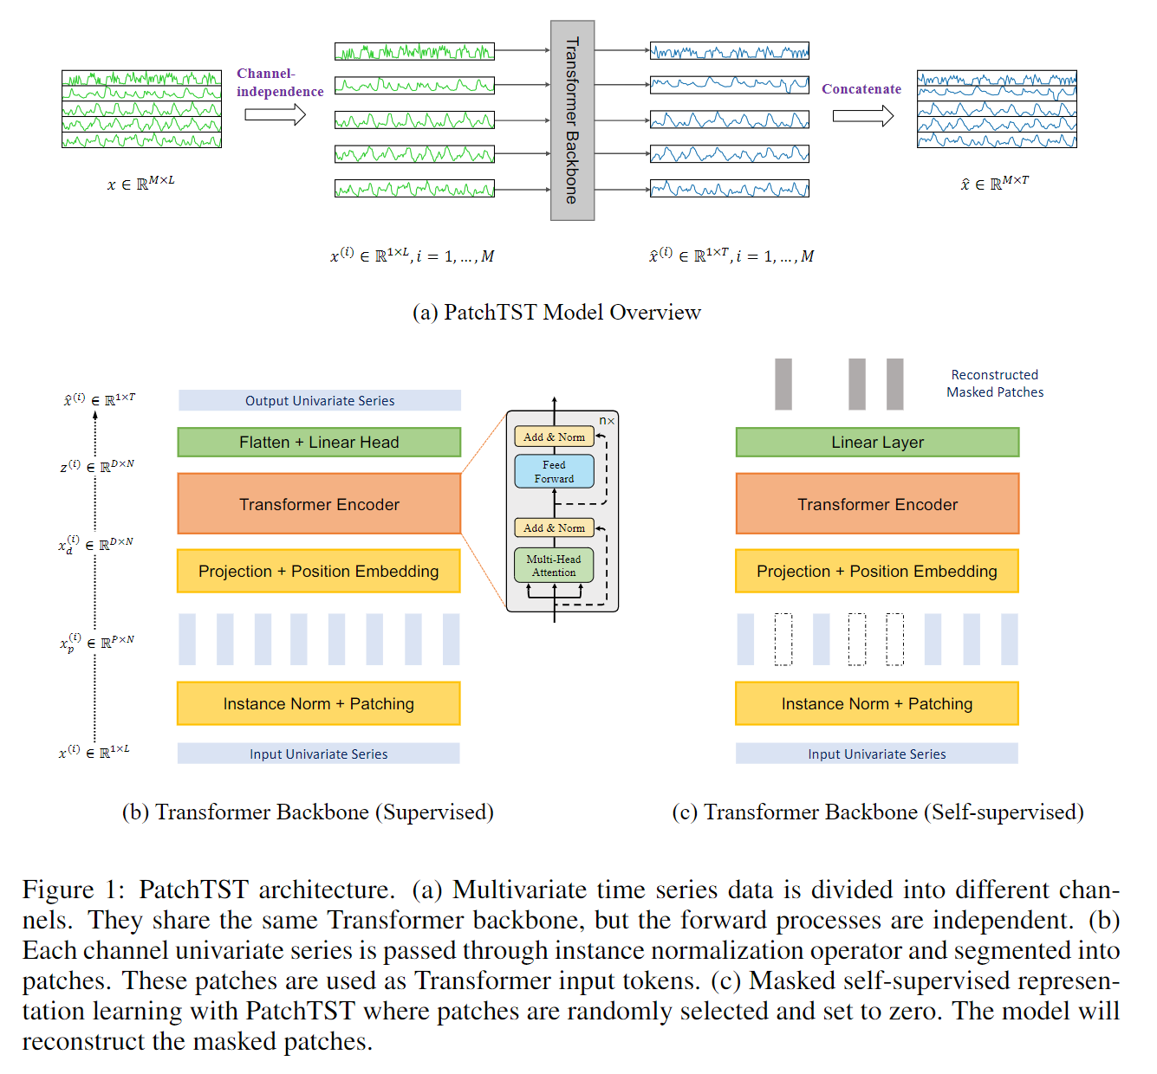
PatchTST Architecture (Original)
Notes:
The original PatchTST model is designed for time series forecasting, where the goal is to predict future values based on historical data.
The model works by treating each feature or channel of the multivariate time series independently. This means that each univariate time series, like temperature or humidity, is processed separately.
The input series is fed through a Transformer Backbone, which analyzes patterns in the data.
After processing, the model produces a series of predicted values for each channel. These predicted series are then concatenated to form the final multivariate forecast.

Slide 11
PatchTST Architecture (Original)
Notes:
The Transformer Backbone in the original PatchTST begins with instance normalization and patching, where the time series is split into smaller segments or patches.
These patches are then projected into a higher-dimensional space and combined with positional embeddings, which help the model understand the order of the data.
These embeddings are processed through the Transformer Encoder, which captures complex patterns and relationships in the data, and outputs an encoding for each patch.
Finally, the model flattens the processed data and applies a linear layer to produce the predicted time series for each feature.

Slide 12
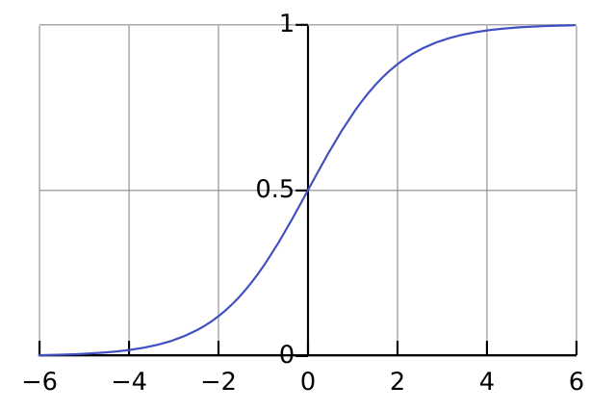


Patch Transformer for CTG Classification
$$p=σ\left(\hat{x}\right)$$
$$p∈[0,1]$$
$$\hat{x}∈ℝ^{1×1}$$
M = 2 (FHR and TOCO)
L = 960 (1 hour)
Notes:
We adapted the PatchTST architecture for binary classification. Instead of forecasting future time series values, the adapted model classifies the entire sequence into one of two categories.
The Transformer Backbone still processes each univariate series independently.
However, instead of outputting a series of predictions, it now produces a single scalar value (logit) using global average pooling applied across the time dimension.
This logit is then passed through a sigmoid function, which converts it into a probability between 0 and 1. This probability tells us the likelihood that the input series belongs to a specific class, such as normal or abnormal CTG signal.

Slide 13

Patch Transformer for CTG Classification
$$\hat{x}∈ℝ^{1×1}$$
Output Logit
Notes:
In the adapted Transformer Backbone for binary classification, the process up to the Transformer Encoder remains the same. The difference comes after the Transformer Encoder.
Instead of producing a sequence of future values, the model now outputs a single logit, which represents the raw score for the classification.
This logit is then passed through a sigmoid function to produce a probability that tells us whether the input series belongs to a specific class.
The core processing steps of PatchTST remain the same, the final blocks and output have been adapted for binary classification.

Slide 14
Hyperparameter Tuning
Hyperparameter | Description | Search Space | Def (0.73) | T#55 (0.79)
e_layers | Number of Encoder Layers | 3, 4, 5, 6 | 3 | 4
n_heads | Number of Attention Heads | 8, 16, 32 | 16 | 8
d_model | Model Dimension | 64, 128, 192, 256, 384, 512 | 128 | 128
d_ff | Feedforward Network Dimension | 128, 192, 256, 320, 384, 512, 640 | 256 | 640
patch_len | Patch length | 4, 8, 16 | 16 | 8
kernel_size | Kernel size | 15, 25, 31 | 25 | 31
stride | Stride | 4, 8, 16 | 8 | 8
dropout | Dropout Probability in Encoder | 0.1, 0.2, 0.3, 0.4, 0.5 | 0.4 | 0.2
fc_dropout | Dropout in Fully Connected Layers | 0.1, 0.2, 0.3, 0.4, 0.5 | 0.2 | 0.1
head_dropout | Dropout in Attention Heads | 0.0, 0.1, 0.2 | 0 | 0.1
activation | Activation function | ‘relu’, ‘gelu’, ‘elu’ | gelu | relu
lr | Learning Rate | 1e-6, 5e-6, 1e-5, 5e-5, 1e-4, 5e-4, 1e-3 | 5e-5 | 1e-4
batch_size | Batch Size for Training | 16, 32, 48, 64 | 64 | 32

Slide 15
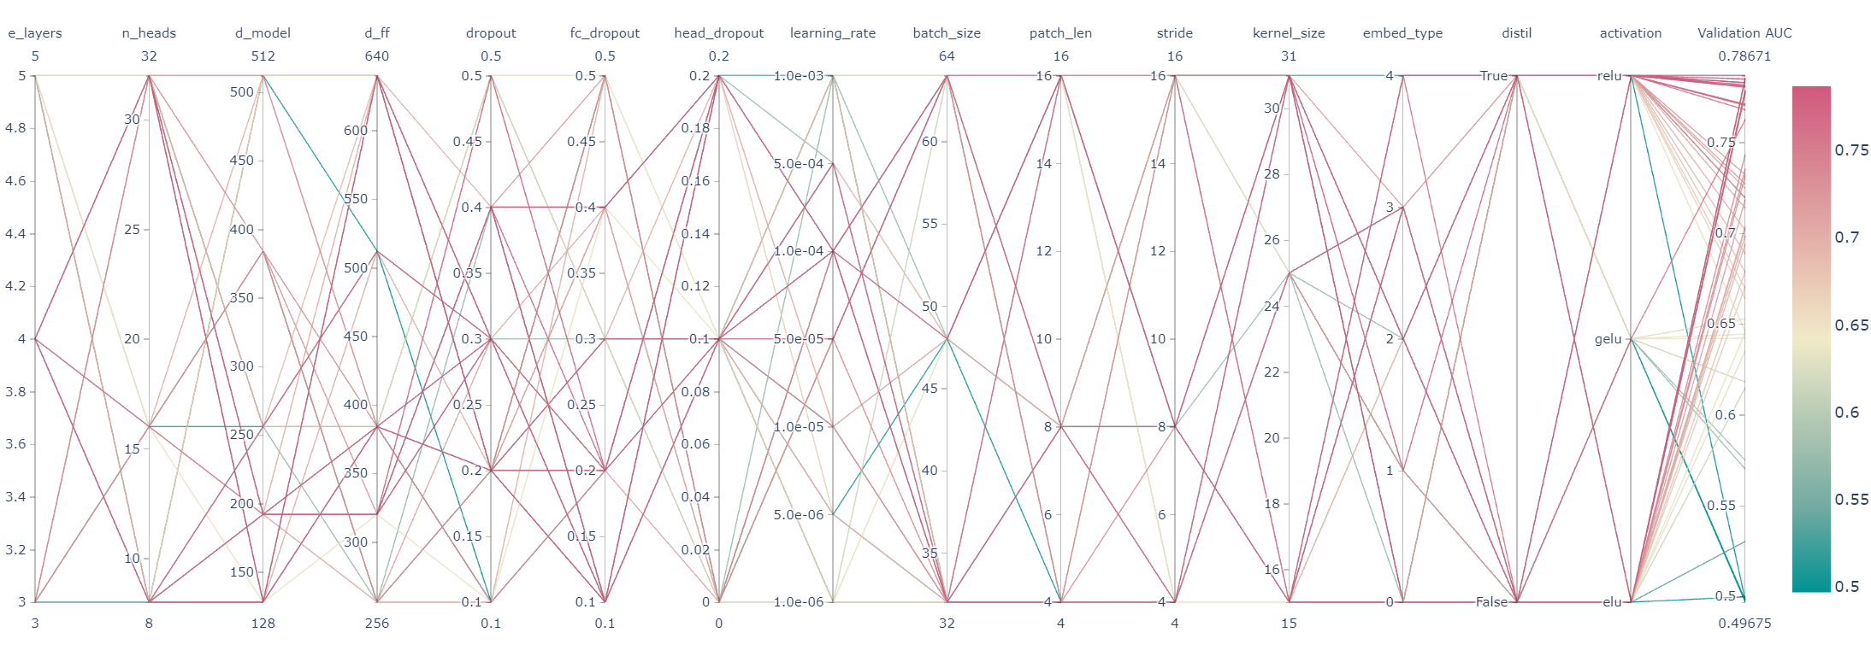
Hyperparameter Tuning

Slide 16
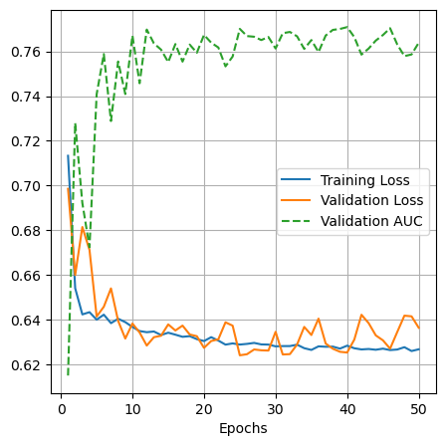
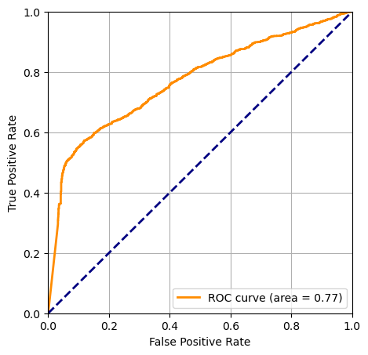
Results
Training on the complete dataset (~20k CTGs) with cases having Diff <= 7 days: 0.7701 AUC

Slide 17
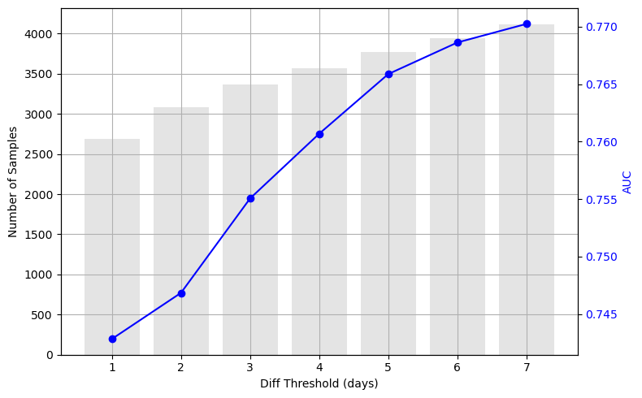
Results
Training on the complete dataset (~20k CTGs) with cases having Diff <= 7 days: 0.7701 AUC
Threshold | 0.50 (Default) | 3.27e-4 (Youden’s Index) | 0.00 (High Sensitivity) | 0.62 (High Specificity)
Sensitivity | 0.48 | 0.57 | 0.95 | 0.47
Specificity | 0.95 | 0.88 | 0.15 | 0.95
PPV | 0.89 | 0.81 | 0.50 | 0.89
NPV | 0.67 | 0.70 | 0.77 | 0.70
F1 | 0.62 | 0.67 | 0.66 | 0.62
Accuracy | 0.73 | 0.74 | 0.53 | 0.73

Slide 18
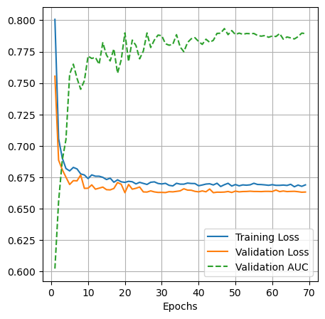
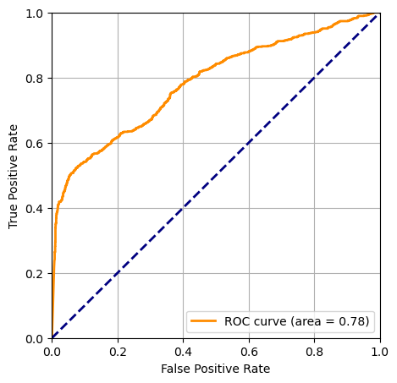
Results
Pretraining on the subset with cases having Diff 3-7 days: 0.7840 AUC

Slide 19
Results
Pretraining on the subset with cases having Diff 3-7 days: 0.7840 AUC
Threshold | 0.50 (Default) | 1.65e-7 (Youden’s Index) | 0.00 (High Sensitivity) | 6.24e-7 (High Specificity)
Sensitivity | 0.38 | 0.52 | 0.95 | 0.49
Specificity | 0.98 | 0.93 | 0.18 | 0.99
PPV | 0.91 | 0.71 | 0.28 | 0.77
NPV | 0.82 | 0.85 | 0.91 | 0.84
F1 | 0.54 | 0.60 | 0.44 | 0.60
Accuracy | 0.83 | 0.82 | 0.38 | 0.83

Slide 20
Results
Testing on the subset with cases having Diff <=2 days: 0.7246 AUC
Threshold | 0.50 (Default) | 5.9e-6 (Youden’s Index) | 0.00 (High Sensitivity) | 1.1e-4 (High Specificity)
Sensitivity | 0.24 | 0.46 | 0.95 | 0.35
Specificity | 0.99 | 0.88 | 0.10 | 0.95
PPV | 0.94 | 0.63 | 0.31 | 0.75
NPV | 0.75 | 0.79 | 0.82 | 0.77
F1 | 0.38 | 0.53 | 0.47 | 0.48
Accuracy | 0.77 | 0.76 | 0.35 | 0.77

Slide 21
Results
Finetuning (complete training) on the subset with cases having Diff <= 2 days: 0.7440 AUC
Threshold | 0.50 (Default) | 1.89e-4 (Youden’s Index) | 0.00 (High Sensitivity) | 1.35e-3 (High Specificity)
Sensitivity | 0.34 | 0.77 | 0.37 | 0.79
Specificity | 0.98 | 0.87 | 0.13 | 0.95
PPV | 0.87 | 0.63 | 0.32 | 0.78
NPV | 0.78 | 0.81 | 0.86 | 0.79
F1 | 0.49 | 0.56 | 0.48 | 0.54
Accuracy | 0.79 | 0.77 | 0.37 | 0.79

Slide 22
Results
Finetuning (linear probing) on the subset with cases having Diff <= 2 days: 0.7458 AUC
Threshold | 0.50 (Default) | 4.3e-9 (Youden’s Index) | 0.00 (High Sensitivity) | 0.99 (High Specificity)
Sensitivity | 0.31 | 0.52 | 0.95 | 0.42
Specificity | 0.99 | 0.88 | 0.13 | 0.95
PPV | 0.91 | 0.65 | 0.32 | 0.78
NPV | 0.77 | 0.81 | 0.86 | 0.79
F1 | 0.46 | 0.58 | 0.48 | 0.54
Accuracy | 0.78 | 0.77 | 0.38 | 0.79

Slide 23
Results
K fold cross validation (model pre-trained on the dataset with cases diff 3-7 and finetuned on each fold)
 | Fold 0 | Fold 1 | Fold 2 | Fold 3 | Fold 4 | Fold 5 | Fold 6 | Fold 7 | Fold 8 | Fold 9
AUC | 0.51 | 0.53 | 0.49 | 0.54 | 0.52 | 0.50 | 0.53 | 0.56 | 0.51 | 0.52
Sensitivity | 0.23 | 0.32 | 0.32 | 0.39 | 0.17 | 0.35 | 0.87 | 0.39 | 0.33 | 0.32
Specificity | 0.85 | 0.77 | 0.73 | 0.70 | 0.90 | 0.69 | 0.20 | 0.72 | 0.74 | 0.74
PPV | 0.61 | 0.58 | 0.54 | 0.56 | 0.63 | 0.53 | 0.52 | 0.58 | 0.56 | 0.56
NPV | 0.53 | 0.53 | 0.52 | 0.53 | 0.52 | 0.51 | 0.60 | 0.54 | 0.52 | 0.52
F1 | 0.33 | 0.41 | 0.40 | 0.46 | 0.26 | 0.42 | 0.65 | 0.46 | 0.41 | 0.41
Accuracy | 0.54 | 0.54 | 0.52 | 0.54 | 0.53 | 0.52 | 0.53 | 0.55 | 0.53 | 0.53

Slide 24
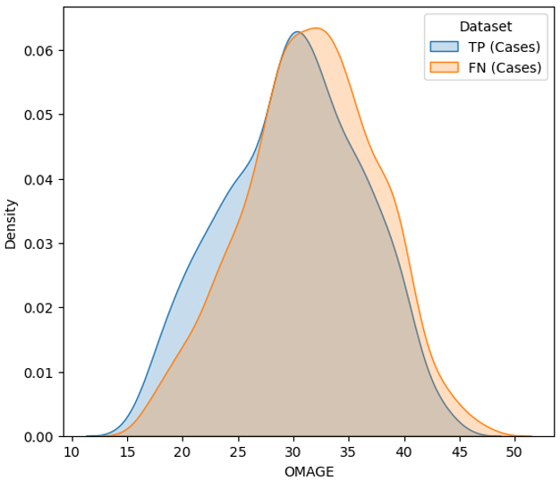
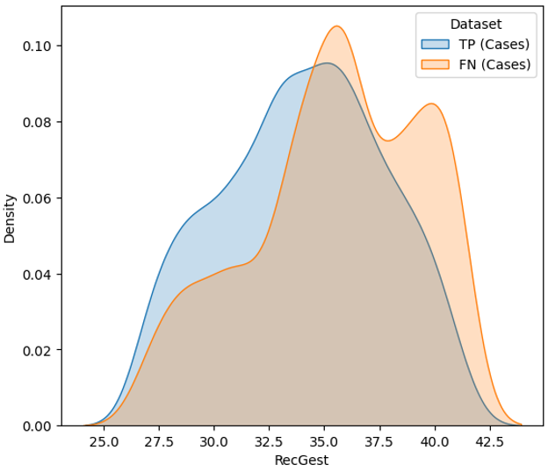
Misclassification Interrogation
The model tends to misclassify cases associated with older mothers and pregnancies with longer gestational ages
Notes:
The model tends to misclassify cases where the mother is older and the pregnancy is more advanced. This suggests that older mothers and pregnancies at a more mature gestational age may produce CTG signals that resemble normal outcomes, leading to false negatives.

Slide 25
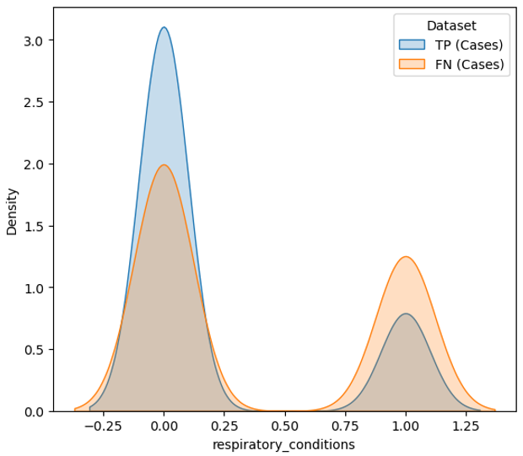
Misclassification Interrogation
The model misclassifies a large proportion of cases with respiratory conditions
Notes:
The model misclassifies a large proportion of cases with respiratory conditions, potentially because the CTG signals from these cases may appear more similar to controls, despite clinical complications. This suggests a gap in how the model interprets CTG patterns related to respiratory distress.

Slide 26
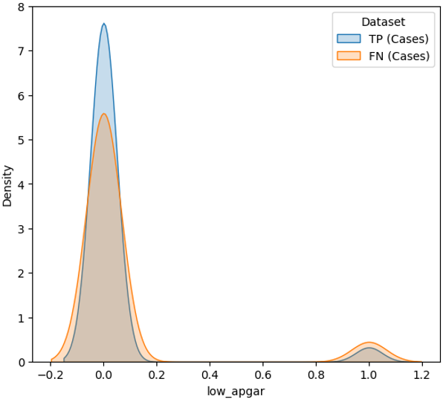
Misclassification Interrogation
The model struggles to correctly classify cases with low Apgar scores

Slide 27
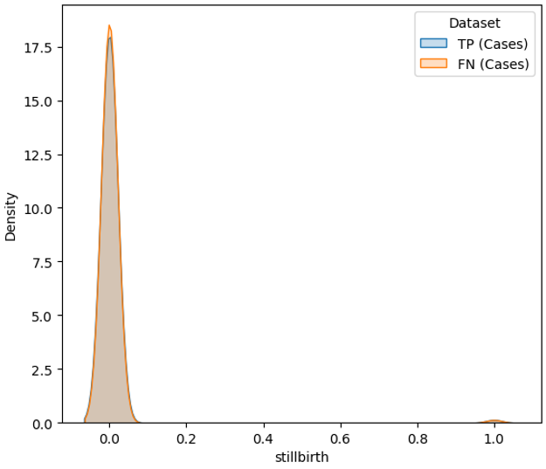
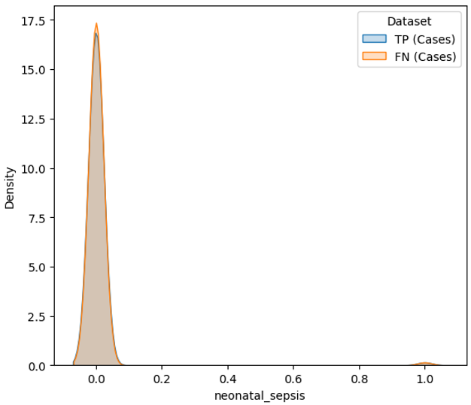
Misclassification Interrogation
The model struggles to effectively learn CTG patterns linked to stillbirth, neonatal sepsis, HIE and asphyxia

Slide 28
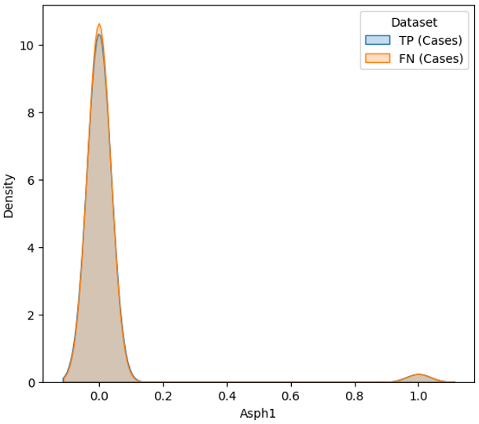
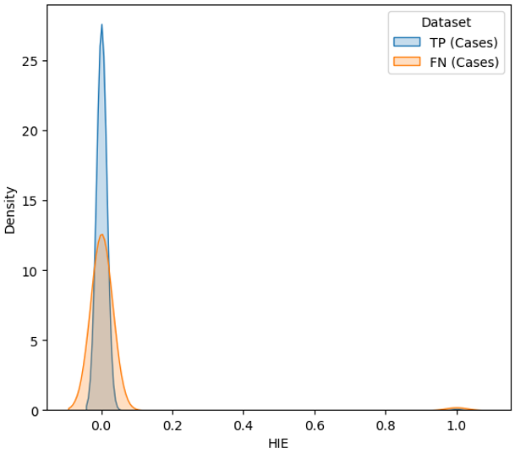
Misclassification Interrogation
The model struggles to effectively learn CTG patterns linked to stillbirth, neonatal sepsis, HIE and asphyxia

Slide 29
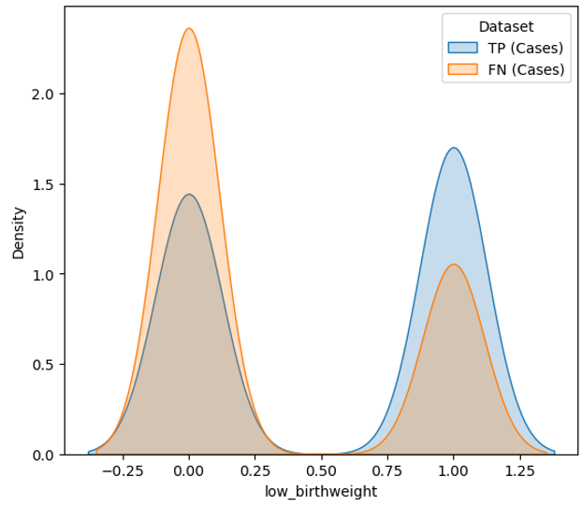
Misclassification Interrogation
The model performs better at identifying cases with low birth weight but struggles when birth weight is within the normal range

Slide 30

Acknowledgement
Gabriel Davis Jones
Chris Redman
Ioana Duta
Beth Albert
Pawel Szafranski
James Bland
Manu Vatish

Slide 31
Thanks!

